Slide 1
Counterfactual Explanations for Multivariate Time Series ﻿On the Mining of Time Series Data Counterfactual Explanations using Barycenters
Counterfactual Explanations for timeseries

Slide 2
Counterfactual Explanation
The counterfactual explanations consist of hypothetical samples that are as similar as possible to the sample that is explained, while having a different classification label; i.e., “if the values of these particular time series were different in the given sample, the classification label would have been different.”
factual
Age | Gender | Education | salary | … | residency | Credit score | Loan amount
24 | F | BS | 120k | .. | USA | 620 | 35k
counterfactual
Age | Gender | Education | salary | … | residency | Credit score | Loan amount
24 | F | MS | 180k | .. | USA | 750 | 30k

Slide 3
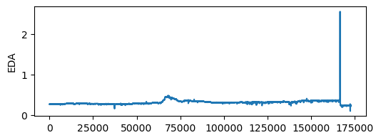
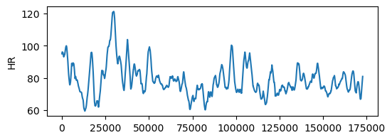
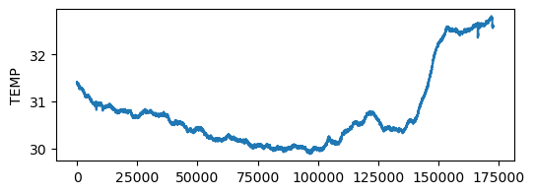
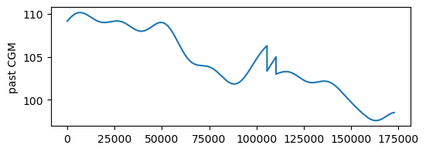
Counterfactual Explanation for timeseries
Manipulating the tiemseries in a way that the class is altered
CF generator
CFs

Slide 4
Counterfactual Explanation for timeseries
Manipulating the tiemseries in a way that the class is altered
distractor
X_test
CF generator
CFs

Slide 5
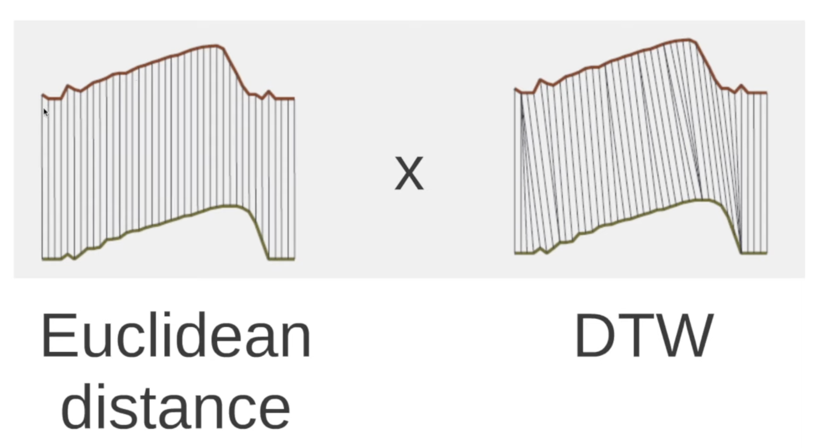
Finding the minimally distant sample
Manipulating the tiemseries in a way that the class is altered
Distance to be calculated using kd-tree (Euclidean, n-neigbors) or Dynamic Time Warping (DTW)
distractor
X_test

Slide 6
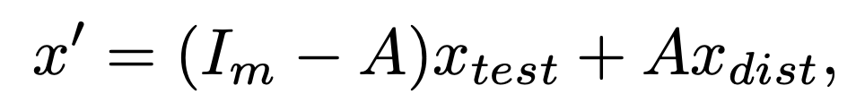
Manipulating the test sample
use a single distractor instead of combining various distractors in one explanation
Empirically, set τ = 0.95 and δ = 3
Distractor X_dist
X_test

Slide 7
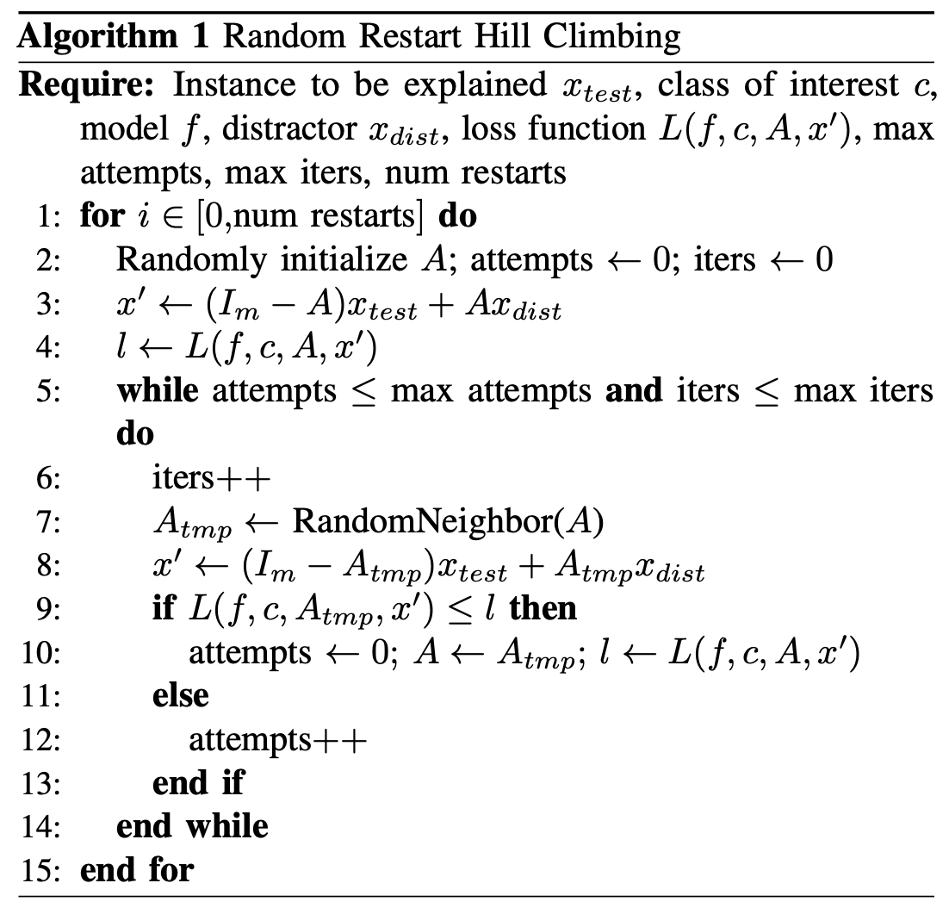
Manipulating the test sample
Sequential Greedy algorithm
Replace one variable at a time
Keep the one that maximizes the class probability
Repeat that until desired class probability is reached
Random Hill Start
Start with a random initialization for A
Look for random neighbors and evaluate L
Repeat until a better neighbor is found
Start with a new A

Slide 8
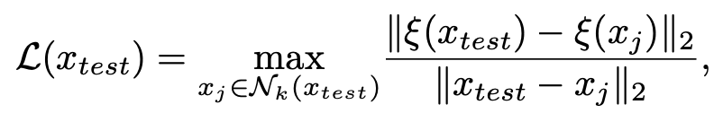
Evaluation Metric
Faithfulness to the original model: An explanation is faithful to the classifier if it reflects the actual reasoning process of the model. We explain a simple model with a known reasoning process and report the precision and recall of our explanations.
Comprehensibility by humans: Understanding an explanation should not require specialized knowledge about ML. A recent survey states that humans prefer only 1 or 2 causes instead of an explanation that covers the actual and full list of causes
Robustness to changes in the sample: A good explanation would not only explain the given sample, but provide similar explanations for similar samples.
Generalizability of explanations: Each explanation should be generalizable to similar samples, i.e., the lessons learned from one explanation should apply to other predictions of the classifier; otherwise, humans using the explanations would not be able to gain an intuitive understanding of the model.

Slide 9
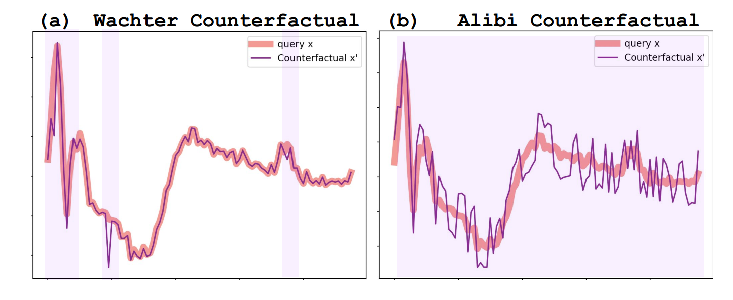
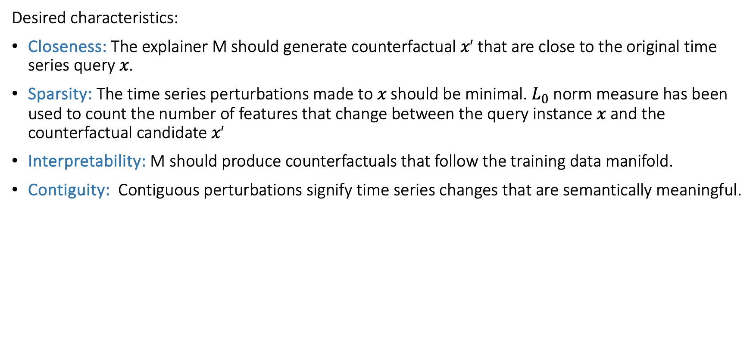
Multivariate timeseries (paper 2)
Desired characteristics:
﻿Closeness: The explainer M should generate counterfactual 𝑥′ that are close to the original time series query 𝑥.
﻿Sparsity: The time series perturbations made to 𝑥 should be minimal. $L_{0}$ norm measure has been used to count the number of features that change between the query instance 𝑥 and the counterfactual candidate 𝑥′
﻿Interpretability: M should produce counterfactuals that follow the training data manifold.
﻿Contiguity: ﻿ Contiguous perturbations signify time series changes that are semantically meaningful.

Slide 10
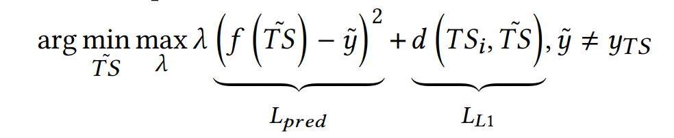
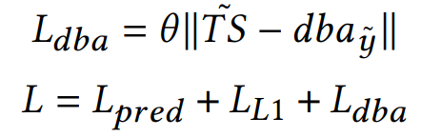

Objective function
﻿Dynamic Barycenter Averaging (DBA) method to find the centroid approximation of the desired class 𝑦˜ that is maximally representative of that class.
$dba_{\tilde{y}}$ (vortex) sample
X_test

Slide 11
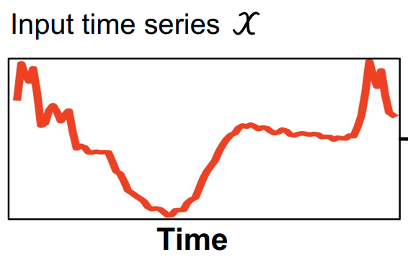
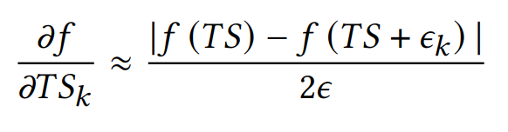
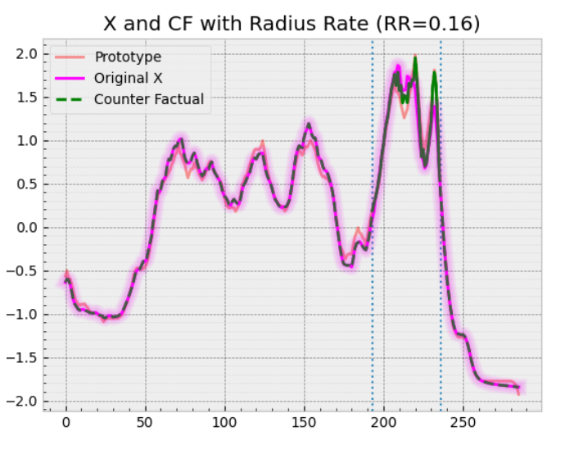
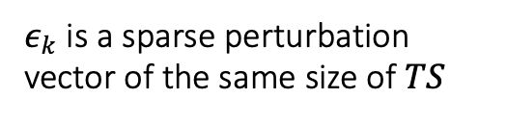
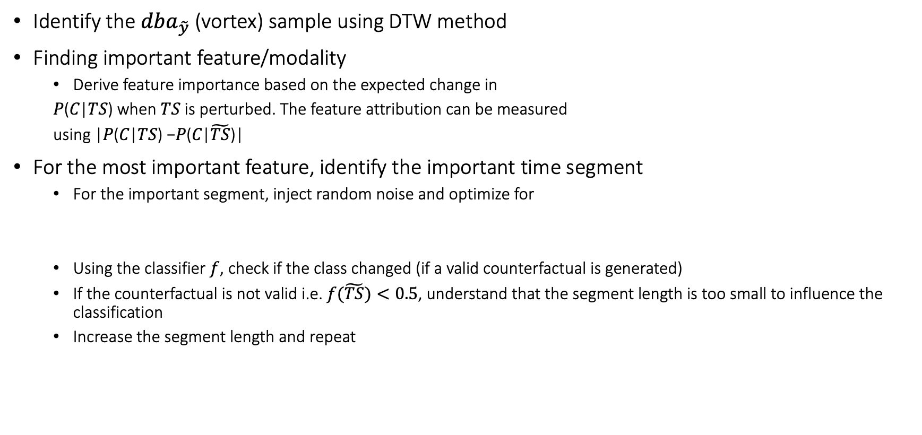
Optimization
Identify the $dba_{\tilde{y}}$ (vortex) sample using DTW method
Finding important feature/modality
Derive feature importance based on the expected change in
𝑃(𝐶|𝑇𝑆) when 𝑇𝑆 is perturbed. The feature attribution can be measured
using |𝑃(𝐶|𝑇𝑆) −𝑃(𝐶|$\tilde{TS}$)|
For the most important feature, identify the important time segment
For the important segment, inject random noise and optimize for
Using the classifier $f$, check if the class changed (if a valid counterfactual is generated)
If the counterfactual is not valid i.e. $f(\tilde{TS})<0.5$, understand that the segment length is too small to influence the classification
Increase the segment length and repeat
r
﻿$ε_{k}$ is a sparse perturbation vector of the same size of 𝑇𝑆

